Slide 1
Linear Regression

Slide 2
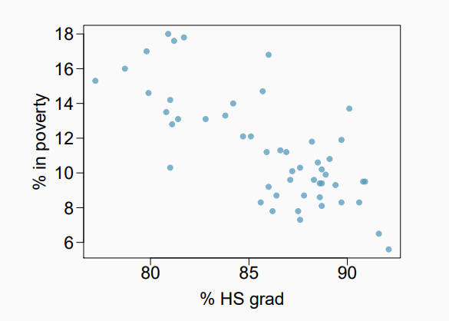
Poverty vs High School Graduation Rate
The scatterplot shows the relationship between HS graduate rate the US and the percentage of residents who live in poverty.
Response variable (dependent): % in poverty
Explanatory variable (independent):
% HS grad
Relationship:
Linear

Slide 3
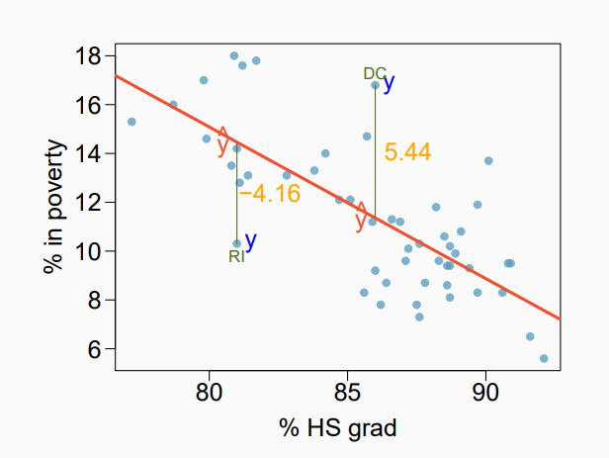
Simple Linear Regression Model
Error between the fitted line and the original Y:
Error term:
e = Y’ - Y
Y’ = 17 + b1 * x
Y’ - predicted, red line
Y - actual Y, blue dot
intercept
slope

Slide 4
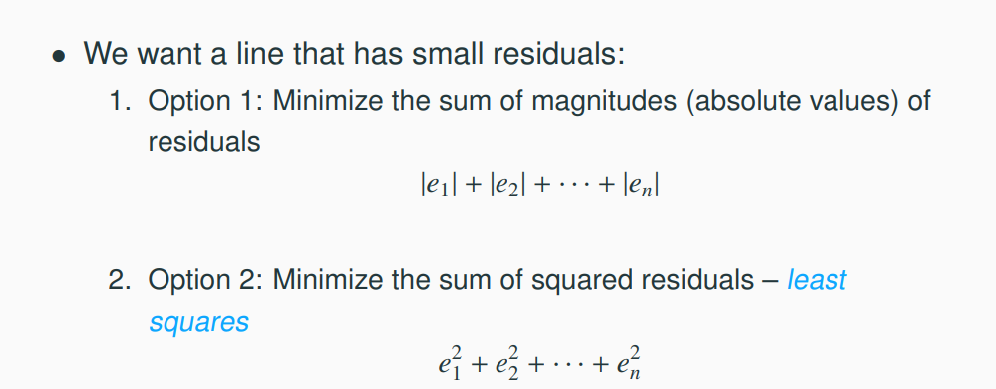
Finding Best Fitting Line

Slide 5
Least Square Regression
Why do we choose to minimize the least squares?
Commonly used
Easy to compute, both by computer or by closed form formula

Slide 6
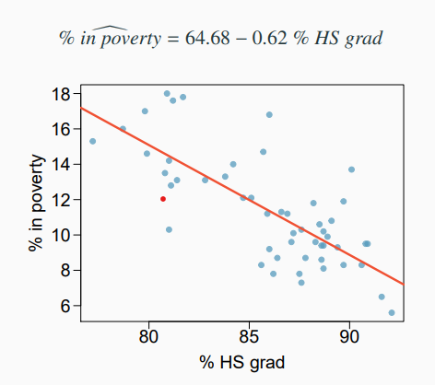
Least Square Regression
By minimizing the least squared errors, we obtain:

